Slide 1



Slide 2
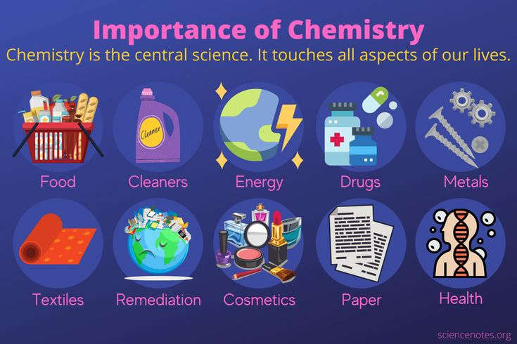
Introduction
Chemistry is the study of matter and its changes
Chemistry plays an important role in our daily life
Everything we use involves chemistry in some way

Slide 3
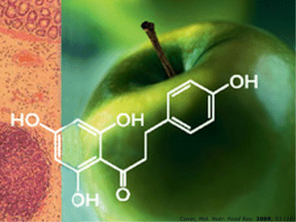
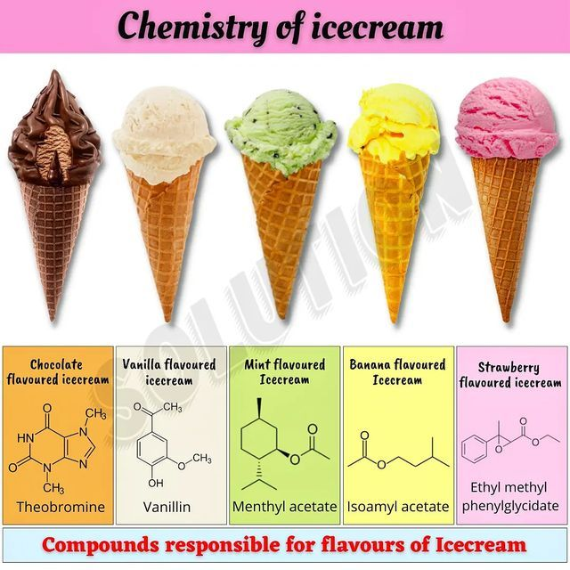
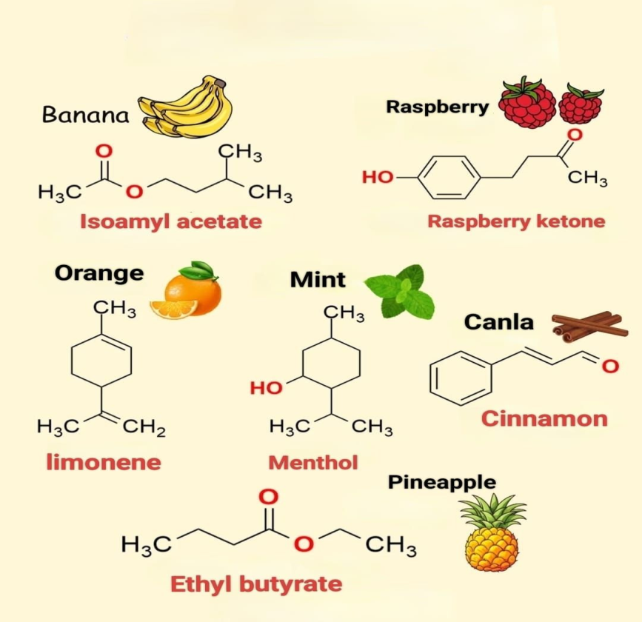
Chemistry in Food
Cooking involves chemical reactions
Fermentation (curd, bread, cheese)
Preservatives prevent food spoilage
Nutrients like proteins, carbohydrates, and fats are chemicals

Slide 4
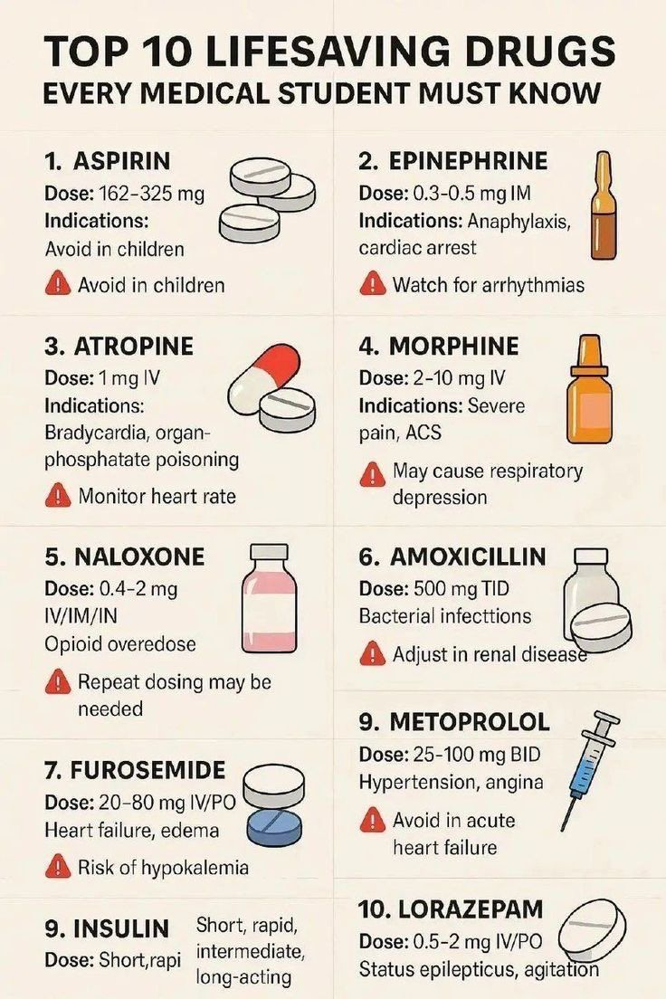
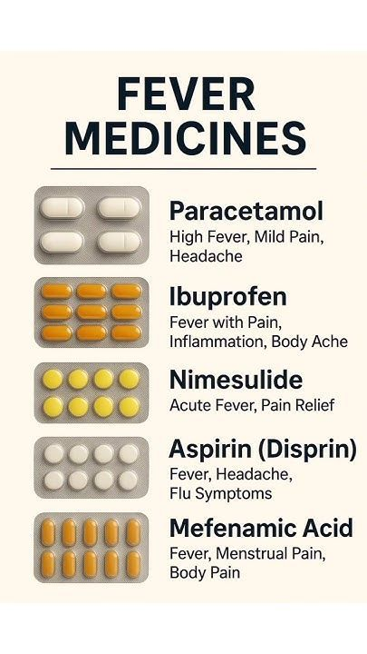
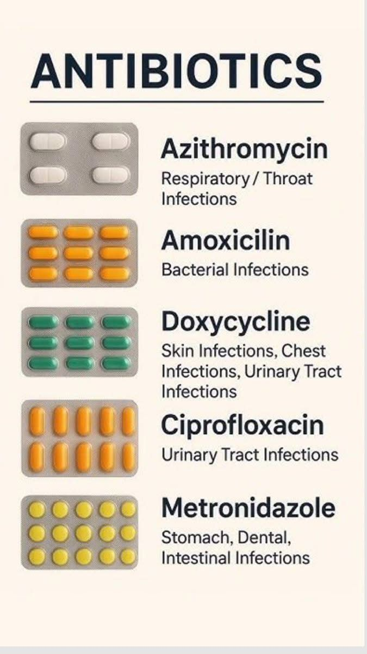
Chemistry in Medicines
Medicines are chemical compounds
Help prevent and cure diseases
Examples:
Paracetamol (pain relief)
Antibiotics (fight infections)
Vaccines are also products of chemistry

Slide 5
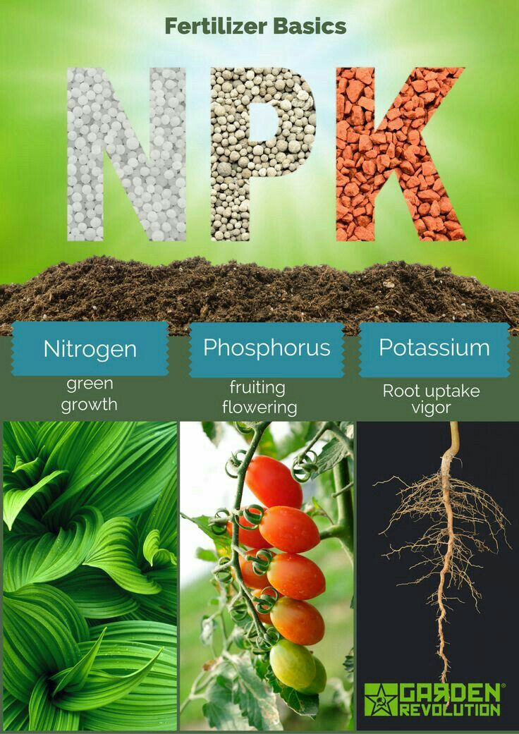
Chemistry in Agriculture
Fertilizers improve soil fertility
Pesticides protect crops from insects
Helps increase food production
Example: Urea, NPK fertilizers

Slide 6
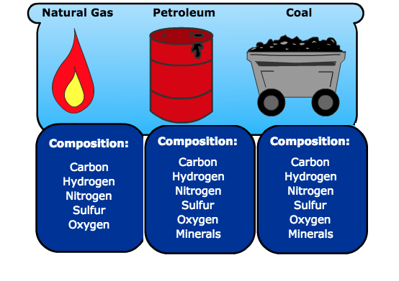
Chemistry in Fuels and Energy
Fuels like petrol, diesel, LPG are chemicals
Used for cooking and transportation
Batteries and solar cells use chemical reactions

Slide 7
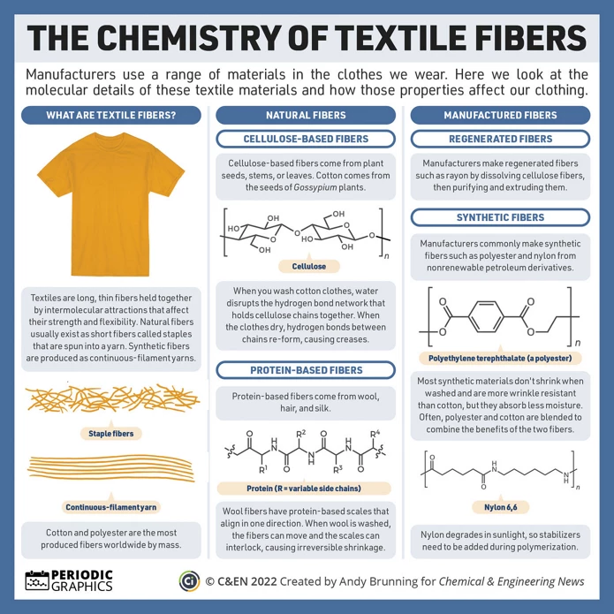
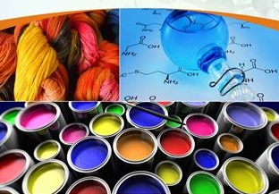
Chemistry in Clothing
Natural fibers: cotton, wool, silk
Synthetic fibers: nylon, polyester
Dyes and detergents
are chemical products

Slide 8
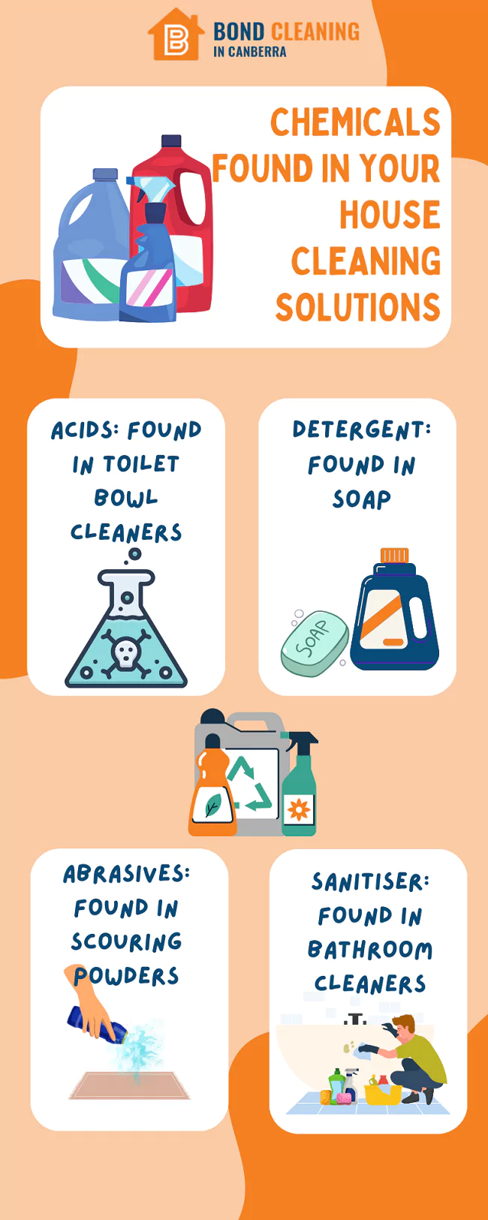
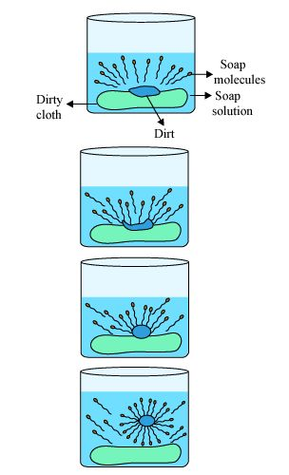
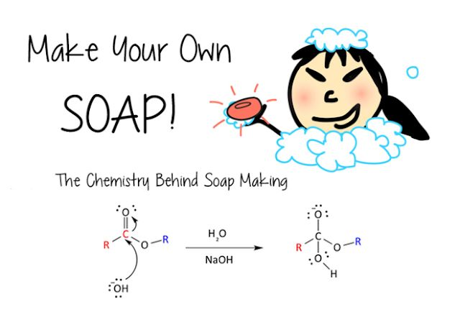
Chemistry in Cleaning Products
Soaps and detergents remove dirt and grease
Disinfectants kill germs
Shampoos and toothpaste contain
chemicals for hygiene

Slide 9
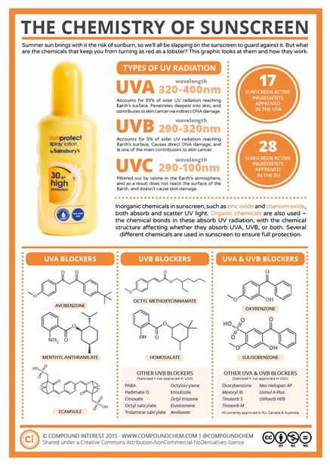
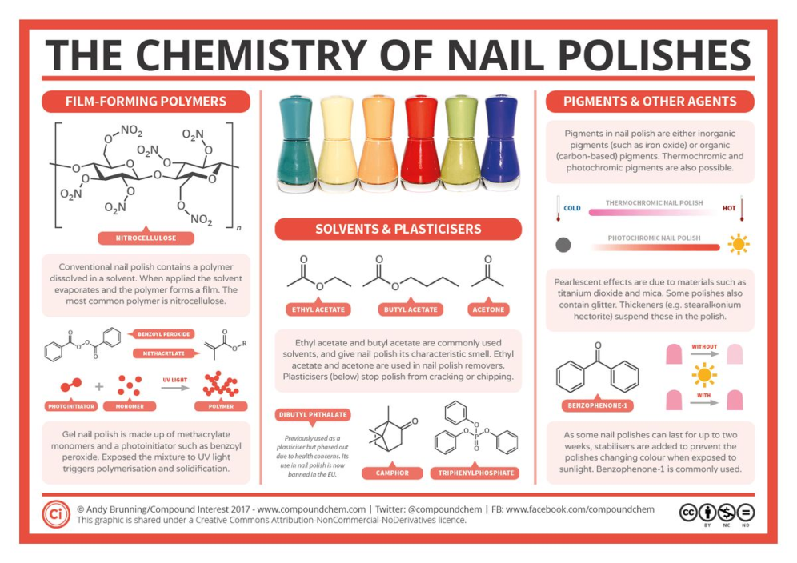
Chemistry in Cosmetics
Used to enhance appearance.
Examples: creams, perfumes, lipstick
Made from safe chemical substances
Perfumes contain alcohol and essential oils

Slide 10
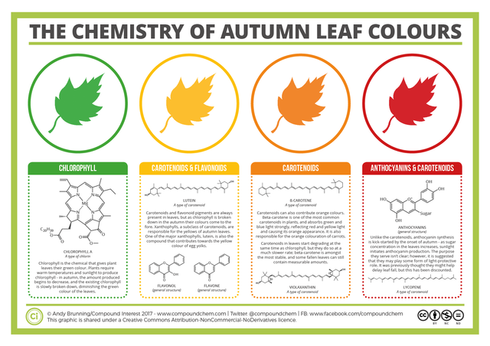
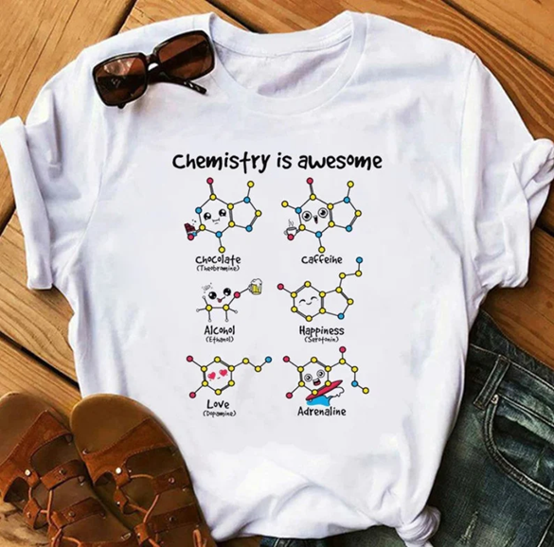
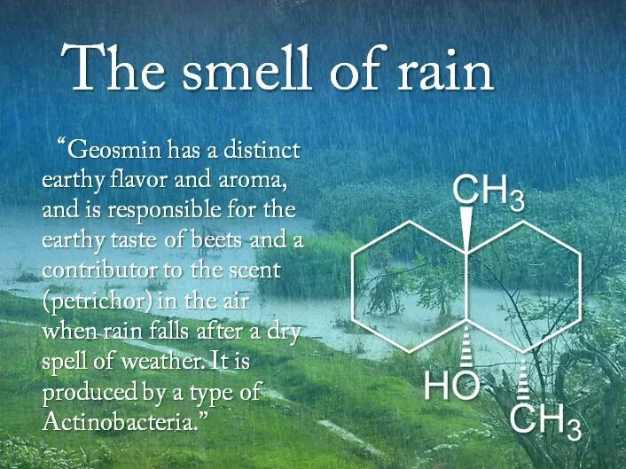
Importance of Chemistry in Daily Life
Involved in basic life processes like metabolism, photosynthesis, respiration, digestion
Improves health and hygiene
Makes life comfortable and easier
Supports industrial and technological development

